Slide 1
BENEFITS FOR SKILLS DEVELOPMENT

Slide 2
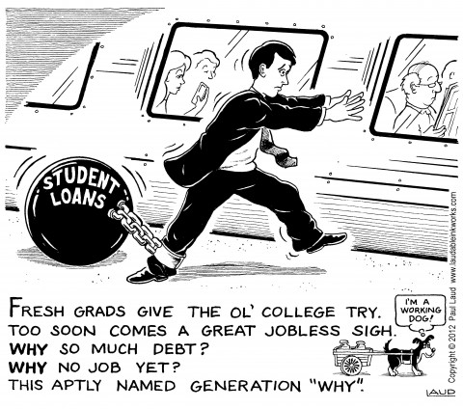

Slide 3
Opportunities in Legislation
The South African government prides itself in education and encourages young people to study further after high school. Studying further is said to equip young people for the workplace and will give them the necessary education/ knowledge needed to compete in the workplace.
This strategy has worked for some and not so much for others, the market is ever evolving which has created a gap between what universities produce and what the job market requires.
The problem that young South Africans now face is unemployment, educated and semi educated alike. Although tertiary institutions provide the educational background that is required in the job market, the skills needed often do not accompany the degree.

Slide 4
Opportunities in Legislation (cont.)
The South African government through numerous policy implementations is trying to combat this long standing problem of unemployment among the youth, particularly unemployed graduates and learners who have passed matric (grade 12).
To combat this problem the SA government has implemented several instruments, amongst others Employment Equity and B-BBEE policies which companies have to comply to.

Slide 5
BBBEE or EEA?
BBBEE compliance is what companies are now striving for, BBBEE in no way, shape or form replaces the Employment Equity Act.
The main differentiation between Employment Equity and BEE is found in the objectives and beneficiaries thereof.
Employment Equity applies only within the context of an employment relationship; the beneficiary base of Employment Equity includes all South African citizens except for white males that are not disabled
BEE applies to the whole business on a much broader basis. The beneficiary base of the BEE Act is focused on black persons and per definition excludes white persons, irrespective of gender or disability, from its ambit.

Slide 6
GOVERNMENT REQUIREMENTS UNDER SKILLS DEVELOPMENT
KEY MEASUREMENT PRINCIPLES
The following criteria must be met in order for the measured entity to receive points on the Skills Development Element Scorecard.
Workplace skills plan, an Annual Training Report and Pivotal Report which are SETA approved; and
Implementation of Priority Skills programme generally and more specifically for black people.
The 6% compliance under the targets also includes external training expenditure for unemployed black people.
A trainee training tool has to be developed in order for the Measured Entity to score under the Bonus Points.
If less than 100% of the trainee are absorbed under the Bonus Points section, the percentage achieved will be recognised.

Slide 7
LABOUR MARKET CHALLENGES
SOFT SKILLS
TALENT SHORTAGE
Many university students face unemployment after graduation
Lack of (relevant) experience is sited as one of the main obstacles
Various research has clearly indicated that organisations report that the necessary soft skills are absent
Recruiting and retaining (black) management talent is a major challenge for organisations in Africa
There is no shortage of candidates that can become management talents
Provided that they are given the right mentoring and personal development attention

Slide 8
THE EXPERIENCE FACTORY SOLUTION
Identify “host” companies, who seek to obtain Skills Development points for B-BBEE;
The enroll Talents on their payroll, pay them a stipend
List the Talents with the relevant SETA in order to get SETA funding
Talent recruitment
Rigorous interview process aimed at selecting candidates with the attitude and motivation to succeed
Incubation and start of 1 year personal development programme

Slide 9
THE EXPERIENCE FACTORY SOLUTION
Identification of Clients
Talents are deployed on project management and consulting projects
They work strictly under the guidance of subject matter experienced professionals to deliver quality services to our clients

Slide 10
THE EXPERIENCE FACTORY SOLUTION
Talents are exposed to real working conditions
Talents receive a minimum of 1 year of individual hard and soft skills development mentoring
Talents are prepared for managerial roles

Slide 11
SERVICES OFFERED TO “HOST” COMPANIES
Handling the recruitment processes
Managing the talents
Ensuring that they attend their SETA courses
Compiling their annual reports
Personal development of the talents
- Performance Measurement
- Talent tailored management
Provide qualified talents
Offer programmes to the talents that bridge the gap

Slide 12
SERVICES OFFERED TO “CLIENT” COMPANIES
Consulting & Project Management
Focus on:
Market research & feasibility studies
Business Process optimazation
IT solutions

Slide 13
COSTS & SAVINGS
Hosts:
Costs: R25k pa (depending on stipend) per talent
Savings: 1. Recruitment time for
- interns
- management talents
2. Management time for supervising and management of interns
Clients:
Costs: Consulting fees related to the Experienced professional

Slide 14
OPPORTUNITIES
There is an opportunity to work with The Experience Factory (“TEF”) in this space
TEF has an established database of graduates in different fields of study
TEF offers you young and inspired youth who are willing to learn.
There is an opportunity for Enterprise Development which will also play a part at increasing your BEE score.

